Slide 1
LAWS2400 / LAWS8040 – Torts
Week 7
Categories: Pure Economic Loss

Slide 2
Outline
  Overview
  Concept of pure economic loss (PEL)
  PEL caused by negligent words
  PEL caused by an act (lecture 2)
  PEL caused by defective structures (lecture 2)

Slide 3
1. Overview
This week: what pure economic loss is, and when the law allows recovery for it
This lecture: loss caused by negligent words.
Lecture 2: negligent acts and defective structures

Slide 4
2. Pure Economic Loss: Readings
Readings:
  Text: Bunn, Allcock, Allison and Shircore, Ch 9 [9.65] to [9.150] (mainly L1)
  Casebook: Topic 7 (Esanda Finance (L1); Perre (L2); Woolcock (L2))
  Recommended reading from S&V on PEL caused by an act and PEL caused by defective structures (L2)
Navigating the text readings for PEL
  the text’s middle headings (‘third party situations’, ‘tort and contract’, etc) can look like separate categories. They are not.

Slide 5
3. Concept of pure economic loss
Pure economic loss (PEL) refers to an economic loss which does not result from any physical injury to the person or property
PEL can be caused intentionally, negligently, or innocently.
PEL may be caused by negligent words, acts or omissions
Note: intentional conduct may also result in PEL which may be actionable under “economic torts” such as deceit/fraudulent misrepresentation/ passing off. This is outside the scope of this unit

Slide 6
Concept of pure economic loss Contd.
See a few illustrative examples of consequential economic loss and pure economic loss:
Consequential Economic loss | Pure Economic Loss
Wage loss due to physical injury | Investment losses due to a negligent financial advice
Medical expenses due to physical injury | Loss of profit due to electrical cable damage
Cost of required home modifications linked to an injury | Diminished property value to due to the architect’s defective advice

Slide 7
Concept of pure economic loss Contd.
The distinction between consequential economic loss and PEL is critical because the latter was not recoverable until recently
Even now, PEL is recoverable only in certain situations if additional conditions are satisfied

Slide 8
Concept of pure economic loss Contd.
There are several policy considerations behind courts’ general reluctance to allow the recovery of PEL:
    Indeterminate liability
    Relationship with law of contract
    Loss linked to a lawful commercial activity

Slide 9
4. PEL caused by negligent words
PEL may be caused by negligent words
Can you think of some examples?

Slide 10
PEL caused by negligent words Contd.
Courts have drawn a distinction between negligent words and negligent actions
Lord Reid in Hedley Byrne observed:
  ‘[T]he law must treat negligent words differently from negligent acts. … Quite careful people often express definite opinions on social or informal occasions, even when they see that others are likely to be influenced by them; and often they do that without taking that care which they would if asked for their opinion professionally, or in business transactions … there can be no duty of care on such occasions.’

Slide 11
PEL caused by negligent words Contd.
At common law, the remedy for fraudulent misstatement was available under deceit
However, the House of Lords in Derry v Peek (1889) ruled that negligent misstatement will not suffice for deceit – rather, it must be an intentional or reckless misstatement
That is where the decision in Hedley Byrne became critical – it created a liability for negligent misstatement at common law

Slide 12
PEL caused by negligent words Contd.
Hedley Byrne & Co v Heller [1964] AC 465
Duty of care for negligent words where a special relationship exists
Lord Reid: the inquirer trusts the speaker to take care, reasonably relies, and the speaker knows or ought to know of the reliance
Lord Morris: a person with special skill who undertakes to apply it for another who relies on it
Recall Topic 5: the disclaimer meant NO duty arose on the facts

Slide 13
PEL caused by negligent words Contd.
Mutual Life & Citizens’ Assurance Co v Evatt (1968) 122 CLR 556
Barwick CJ: information or advice on a serious matter; speaker realises (or should) they are being trusted; reasonable for the recipient to act on it; duty of reasonable care follows
Quoted in your Esanda casebook extract

Slide 14
PEL caused by negligent words Contd.
Shaddock & Associates Pty Ltd v Parramatta City Council (1981) 150 CLR 225
Council told an intending purchaser no road-widening proposal affected the land; there was one
Duty found: covers information as well as advice; no separate requirement that the speaker possess special skill

Slide 15
PEL caused by negligent words Contd.
San Sebastian Pty Ltd v Minister (1986) 162 CLR 340
A duty can arise without any request, e.g. known special competence; assumption of responsibility; inviting or intending reliance; an interest in the recipient acting
Brennan J's conditions: representor realises the representee will trust their special competence; reasonable to accept and rely; reasonably foreseeable loss if the statement is wrong

Slide 16
PEL caused by negligent words Contd.
Tepko Pty Ltd v Water Board (2001) 206 CLR 1
‘Ball-park’ costing, given reluctantly; shown to the plaintiff's bank; figure overstated; arrangements collapsed
No duty: the Board neither knew nor should have known of the reliance, and reliance on a reluctant, provisional estimate was not reasonable
Needed: known reliance, an assumption of responsibility, or both

Slide 17
PEL caused by negligent words Contd.
Consider the decision in Esanda Finance Corp v PMH (1997) 188 CLR 241 – in casebook - (Esanda lent money to companies associated with Excel; PMH had audited and certified Excel’s accounts; Esanda alleged that PMH were negligent and consequently it suffered economic loss after Excel was placed into receivership)

Slide 18
PEL caused by negligent words Contd.
The question before the High Court was whether PMH owed a duty of care to Esanda
The High Court held that no such duty existed – no circumstances which might serve to establish any relationship of proximity between Esanda and PMH

Slide 19
PEL caused by negligent words Contd.
Dawson J observed:
  ‘the mere foreseeability of harm does not, where the only harm is pure economic loss, give rise to a duty of care. The reason for this is that a duty of care imposed by reference to the mere foreseeability of harm in the form of financial loss would extend liability in negligence beyond acceptable bounds. … for a duty of care to arise in cases of pure economic loss, the law requires, in addition to the foreseeability of harm, a special relationship between the parties which is described as a relationship of proximity.’

Slide 20
PEL caused by negligent words Contd.
The Court in Esanda identified several factors that could establish the necessary ‘proximity’* or ‘special relationship’ for pure economic loss claims in addition to reasonable foreseeability:
  Reasonable Reliance
  Nature of Relationship
  Special skill or knowledge
  Knowledge of Reliance
  Assumption of Responsibility
*Note: 'proximity' is the historical label; the modern approach treats these as salient factors (Sullivan v Moody)

Slide 21
PEL caused by negligent words Contd.
McHugh J gave several policy reasons why auditors should not have a duty of care to third parties
    increase in the cost of auditing services
    more complex litigation
    risk of indeterminate liability
    difficulties of proving reliance

Slide 22
PEL caused by negligent words Contd.
Disclaimers and assumption of responsibility
  A disclaimer is one factor against a duty arising (Hedley Byrne itself: no duty arose)
  Distinguish: disclaimer of responsibility (excludes the duty) vs warning that care has not been taken (goes to whether reliance was reasonable)
  Mallonland Pty Ltd v Advanta Seeds Pty Ltd [2024] HCA 25: ‘assumption of responsibility’ is imprecise; understood as an undertaking to take on a task from which acceptance of reasonable care can be inferred

Slide 23
PEL caused by negligent words Contd.
Vulnerability
Anchorage Capital Master Offshore Ltd v Sparkes (2023) 111 NSWLR 304
Lenders relied on false financial notices from the borrower's officers; company collapsed; no duty
Sophisticated commercial parties able to protect themselves by contract are not vulnerable

Slide 24
PEL caused by negligent words Contd.
Statutory liability for misstatements
Now there are also statutory provisions which provide for liability for misrepresentation
For example, Section 18 of the Australian Consumer Law provides:
  ‘A person must not, in trade or commerce, engage in conduct that is misleading or deceptive or is likely to mislead or deceive.’

Slide 25
PEL caused by negligent words Contd.
Section 18 covers both conduct and words
Under Section 18, no need to establish a duty of care or prove negligence – rather, what needs to be proved is the existence of misleading or deceptive conduct
Yet, common law remains relevant, e.g., in cases where the defendant is not engaging ‘in trade or commerce'

Slide 26
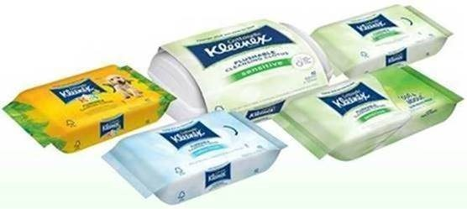
PEL caused by negligent words Contd.
Consider the decision in ACCC v Kimberly-Clark Australia [2019] FCA 992 (first instance); [2020] FCAFC 107 (appeal) (ACCC brought action on two counts: whether the wipes were ‘flushable’ and ‘made in Australia’)

Slide 27
PEL caused by negligent words Contd.
The Federal Court found that the ‘made in Australia’ claim was false and misleading – the wipes were made elsewhere!
However, the Court ruled that Kimberly-Clarke had not made false and misleading claims about the ‘flushable wipes’ – this was upheld on appeal by the Full Federal Court

Slide 28
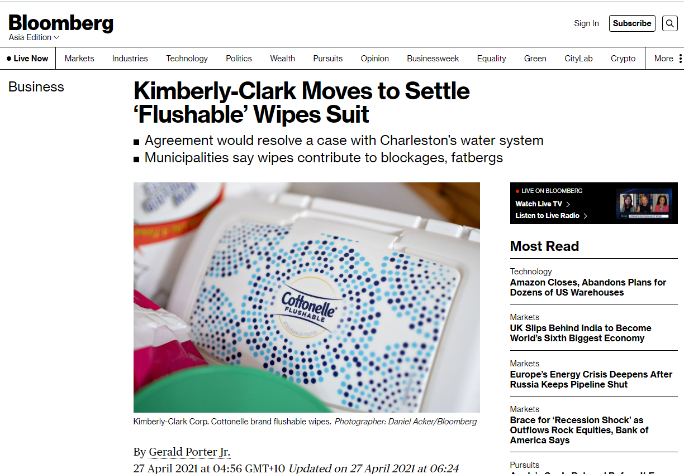
PEL caused by negligent words Contd.
It is worth noting that Kimberly-Clarke had faced similar actions in the US and it decided to settle out of court

Slide 29
PEL caused by negligent words Contd.
Approaching duty of care for PEL by negligent misstatement
Factors relevant to the inquiry include (ie the relevant salient features)
  Reasonable foreseeability (necessary but not sufficient)
  Indeterminacy of liability
  Category of relationship
  Defendant’s knowledge (of matters affecting the plaintiff, including reliance)
  Reliance by plaintiff (reasonable in the circumstances?)
  Assumption of responsibility by defendant
  Special skill of defendant
  Vulnerability of plaintiff
Note: not a rigid checklist; there is a cross over between factors depending on the circumstances; courts look to the circumstances as a whole.

